Slide 1


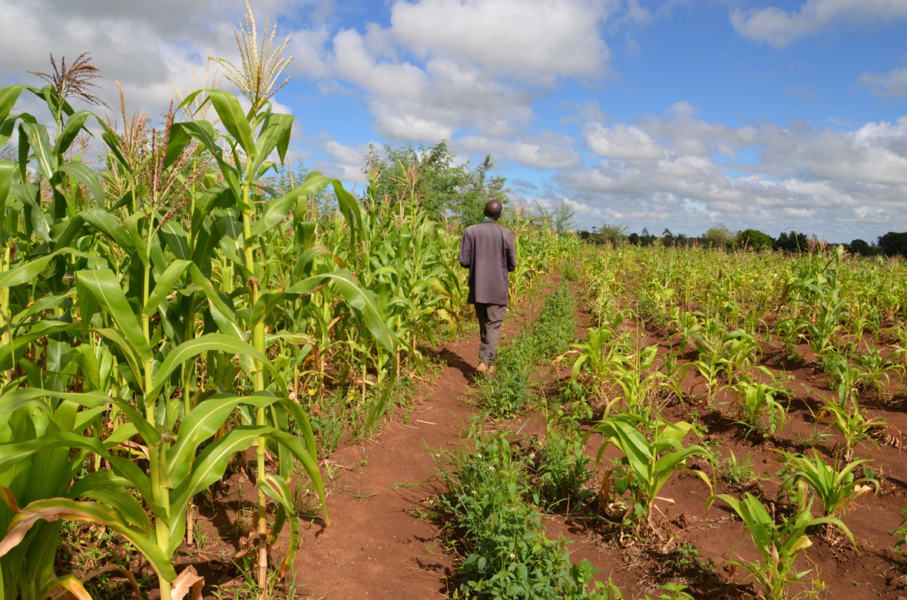

TAMSAT-ALERT for Impact-Based Forecasting
Session 4: Interpreting TAMSAT-ALERT forecasts

Slide 2


Overview
Work through questions 1-11 on the worksheet
Please do that before continuing this presentation
Listen-along presentation (10-15 minutes)
Forecast figures explained
Complete worksheet
Review and update your understanding

Slide 3
Learning objectives
Explain TAMSAT-ALERT soil moisture and WRSI as a drought impact-relevant metric
Understand modelling of soil moisture and WRSI
Understanding TAMSAT-ALERT approach to forecasting
Ability to interpret TAMSAT-ALERT soil moisture and WRSI forecasts
Ability to produce TAMSAT-ALERT forecast plots and/or bulletins

Slide 4
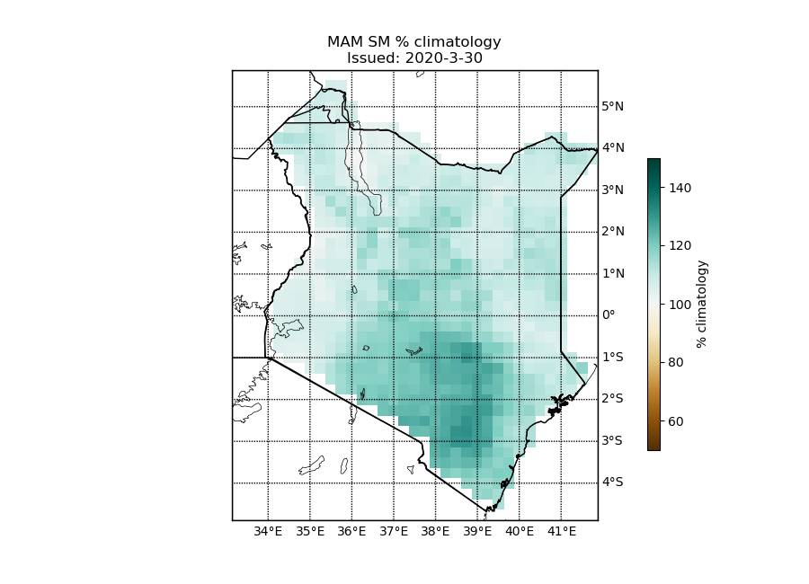
Figure 1.
Generally, forecast for above average soil moisture across Kenya
Spatial variation
Near average / slightly enhanced soil moisture in West and North-East
Substantially above average (>20%) in South-Central region
Forecast date
Still large proportion of the season to come
Much uncertainty
Impact on pasture / crop
Soil moisture unlikely to be limited
Potential negative impact due to flooding

Slide 5
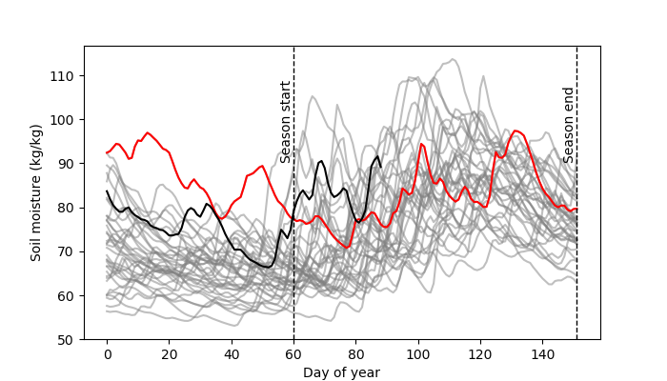
Figure 2.
Averaged across Kenya
Generally, one of wetter years compared to climatology
2020 similar to 1998 – both followed heavy OND rains
2020 not as wet through January and February as 1998, but early start to MAM rainfall has elevated 2020 above 1998 soil moisture

Slide 6
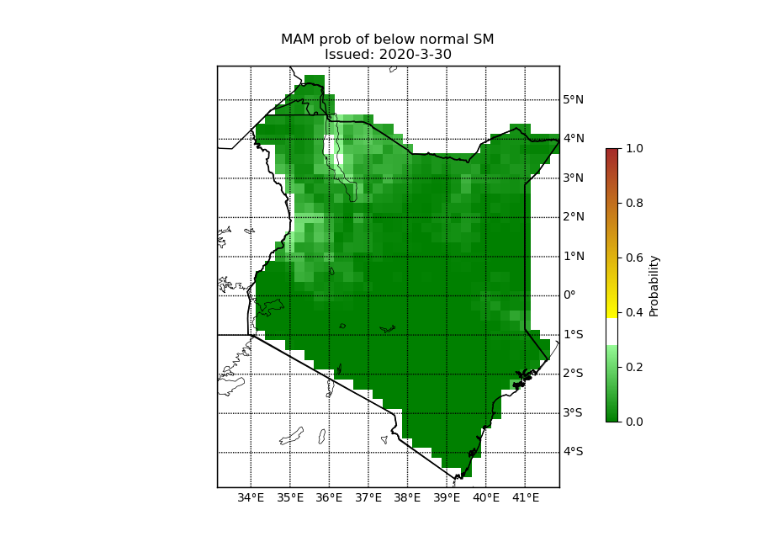
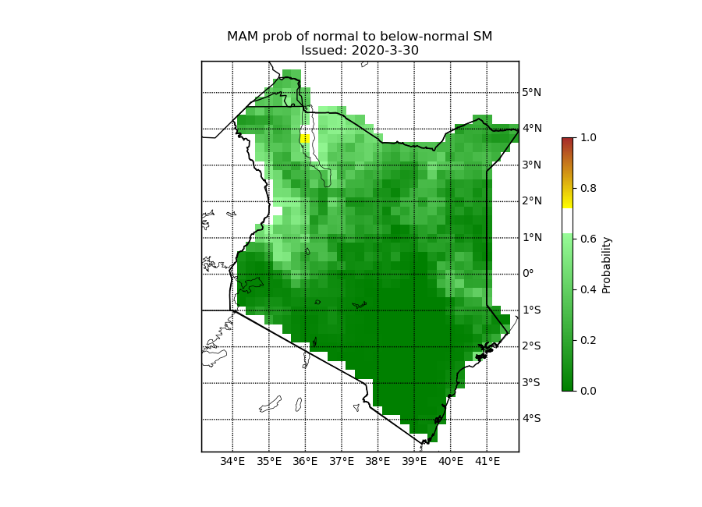
Figure 3.
Low probability of lower-tercile soil moisture
Low probability of mid-tercile soil moisture
Enhanced probability of upper tercile soil moisture
Spatial variation
South Central Kenya – zero probability of lower or mid tercile
More uncertain in North-East and West
A
B

Slide 7
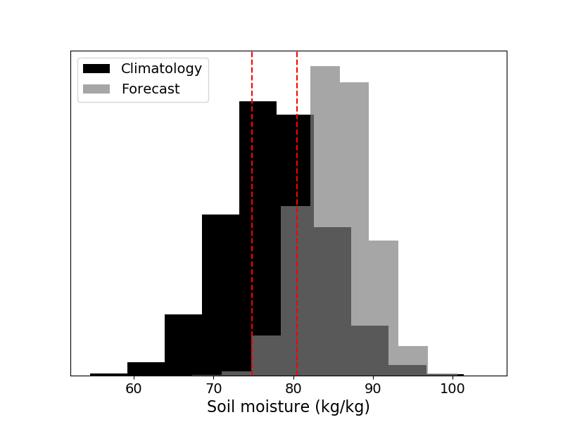
Figure 4.
Averaged across Kenya
Probability of enhanced soil moisture greater in forecast than climatology
Only small portion of forecast probability distribution below 33rd percentile – only small chance of lower tercile soil moisture
Large proportion of probability distribution above 67th percentile – enhanced likelihood of above average soil moisture

Slide 8
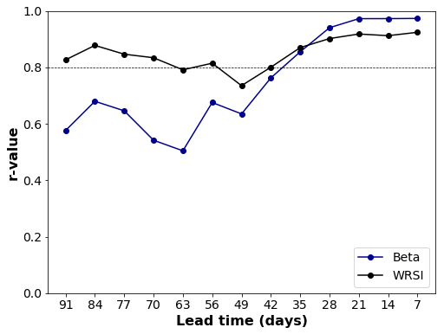
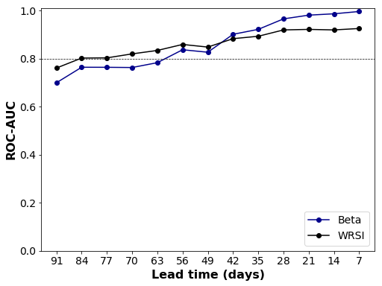
Summary
Enhanced likelihood of upper tercile soil moisture across Kenya in general
Some spatial variation, with South-Central region expected to show greatest positive soil moisture anomaly
Important to remember this forecast made on 30th March
Still 2 months of the season to come and some there is much uncertainty
Keep skill of TAMSAT-ALERT forecasts in mind
Drought impacts unlikely, but chance of water logging and flooding increased
What might this mean for pasture and crops?

Slide 9
What’s next?
Return to the worksheet and complete it
Get in touch
End-of-week clinics (Friday 22nd May @ 10:00 - 11:30am)
Email me (v.l.boult@reading.ac.uk)
Next session: Producing TAMSAT-ALERT forecasts

